Slide 1
Welcome to Health Care Climate Change
Resiliency Mentoring
Webinar #1 Cohort #1
Site Teams, Access Local Risks, Feedback & Resources
April 25, 2017
Canadian Coalition for Green Health Care

Slide 2
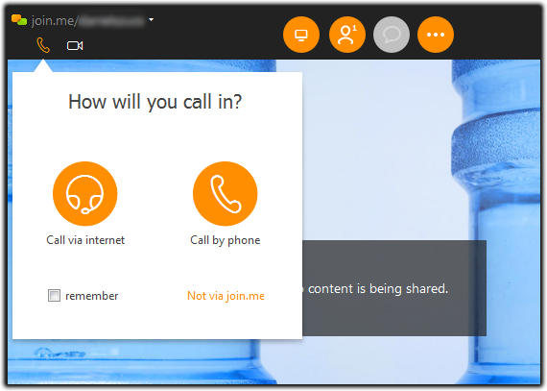
Call in via Internet or Phone for Audio
For slides log into:
https://join.me/963-150-898
Local call-in numbers
Brantford +1.226.401.9363
Montréal +1.514.800.1233
Ottawa +1.613.699.9318
Quebec +1.581.705.4251
Toronto +1.647.977.2648
Vancouver +1.778.654.8779
Winnipeg +1.204.500.0399
Access Code: 963-150-898# Mute/Unmute Phone: press *6

Slide 3
Welcome Cohort # 1 Members
1 | Albright Centre | Beamsville | ON | Jim McArthur | Director of Properties
2 | Fraser Health Authority | Vancouver | BC | Angie Woo | Climate Resilience & Adaptation, Lead
3 | Hamilton Health Sciences | Hamilton | ON | Victoria Brzozowski | Waste Management Coordinator
4 | Hôpital Glengarry Memorial Hospital | Alexandria | ON | Louise Quenneville | Emergency Preparedness Coordinator
5 | Hôpital Montfort | Ottawa | ON | Michel Picard | Directeur – infrastructures
6 | Interior Health | Kelowna | BC | Tanja Stockman | Manager, Environmental Sustainability
7 | North Bay Regional Health Centre | North Bay | ON | Dorthy Duguay | Environmental Services and MDR Dep't.
7 | North Bay Regional Health Centre | North Bay | ON | Eileen Benedictus | Supervisor, Environmental Services
8 | West Park Healthcare Centre | Toronto | ON | Diane Zdybal | Director Support Services
8 | West Park Healthcare Centre | Toronto | ON | Kendra Rainford | Environmental Services Supervisor

Slide 4
Session Objectives
Housekeeping updates: Resiliency Mentoring Logo
Review any questions from Introductory Webinar
Discuss progress/questions each participant has made in identifying:
Your site-specific climate change impacts
Team members to undertake checklist
Prepare for Session #2:
Assess Climate-Related Risks (Questions 1- 19)
Resources: Climate Change and Health Infographics
Reminder – Mentoring Call Schedule

Slide 5
1. Housekeeping
http://greenhealthcare.ca/mentoringcohort
Photo and Job Title/Organisation
Entry Survey

Slide 6
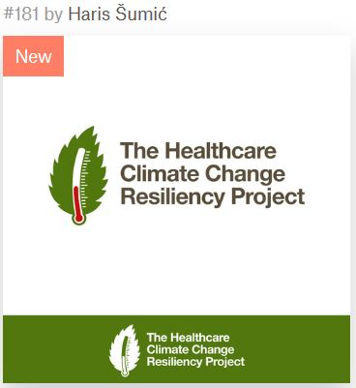
1. Resiliency Mentoring Logo
The HealthCare
CLIMATE CHANGE
Resiliency Project

Slide 7
2. Review Items: Register CC Resiliency Checklist
Go to http://greenhealthcare.ca/mentoring
Log into the Toolkit page and review checklist & resources
Review PPTs from:
Resiliency webinar in March
Introductory Resiliency Mentoring Webinar
Consider need for slide presentation on this project to your team:
Facilitators PPT available which Coalition can update – any interest in this?
Notes:
Does anyone want to do a ppt presentation to new team members?

Slide 8
2. Review Items: HC Resiliency Checklist
Section | Subsection | Questions
Risk Assessment | Assessing risks to inform emergency management and risk reduction strategies | 14
 | Assessing risks to infrastructure and systems | 5
Risk Management | Risk Management to Reduce Climate-Related Risks | 21
 | Procurement of Health Care Resources and Supplies | 4
 | Notifications, Monitoring, and Surveillance | 3
 | Clinical Risk Management | 5
 | Infrastructure and Systems Risk Management | 8
 | Energy Supply and Use | 4
Building Capacity | Sustainable Health Care and Climate Change Mitigation | 14
Total Questions: 78

Slide 9
2. Review Items: Process Steps
Identify climate change risks
Recruit team members from the Emergency Management Committee and others
Leverage existing key committees
Conduct checklist assessment together
Discuss options for what would be useful to the organization beyond our resiliency score

Slide 10
2. Review Items: Time to Complete the Checklist
UHN Experience:
Divide the Checklist for independent research with the right people
Time to coordinate the process 5-8 days
Met face-to-face 4 times to complete the checklist collaboratively
Time invested by team members 2-3 days

Slide 11
2. Review Items: Time Horizon
Last session discussed:
Time horizon of 5-10 years is maximum to keep administrative attention
When should a longer time horizon be considered?
New buildings last 60+ years
Other?

Slide 12
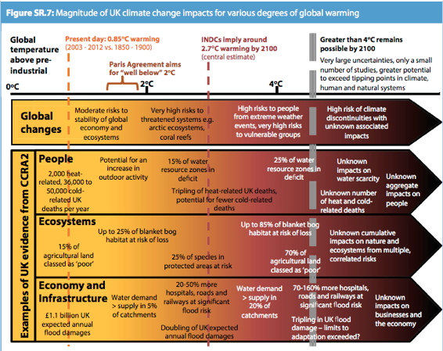
Notes:
UK Climate Change Risk Assessment 2017
In the 2017 CC Risk Assessment – Health care sector is an integral part of report
Note the long term planning aspects. Not common in HC planning window. But senior government can look at it this way.

Slide 13
3.i Assessing your Climate Change Impacts
Review of Climate Change risks
Identify your site specific Climate Change Risks
Record your Climate Change risks on the Checklist
Discussion/Questions
Each cohort member shares their progress and questions

Slide 14
3.i Where is climate change happening in Canada?
Prairies
Hotter and drier weather conditions
Increased severity and length of droughts
Greater frequency of flooding
Warmer winters
Quebec and Ontario
Hotter summers
Warmer winters with less snow
More storms and heavy rain events
Atlantic
Rising sea-level
Greater risk of flooding
Coastal erosion
More intense storms
Arctic
Dramatically higher temperatures
Increased precipitation
Loss of permafrost and sea ice
West Coast
Higher temperatures
Sea level rise, coastal flooding
Increased snow, glacier retreat
More severe spring floods
More frequent and intense summer drought
(from http://
FROM: Public Health Association of Canada
http://www.phac-aspc.gc.ca/hp-ps/eph-esp/fs-fi-a-eng.php
Notes:
Climate change will impact all areas of the country. The nature and the extent will vary across Canada and some of the key projected changes by region are:

Slide 15
3.i Getting Ready – Climate Change Impacts
For UHN:
City of Toronto climate model priority weather drivers:
Increase in extreme weather events
Extreme heat
Higher avg. annual & max. temp.
More intense rain events
Secondary weather drivers
Extreme cold

Slide 16
3.i What are your Climate Change Impacts?
Where you can get info on the impacts of CC for your area:
Review internal info for evidence of CC impacts
i.e. flooding, impacts due to winter storm,
Public Health – local, provincial
Municipality
Conservation Authorities
Experts from local/regional University

Slide 17
3.i Recording Climate Related Risks on Checklist
Climate Risk | Yes | Somewhat | No | I don’t know | This is not a risk for my region
a. Extreme heat
b. Extreme cold
c. Extreme rain and snowfall
d. Drought
e. Wildfire
f. Extreme weather – tornado
g. Extreme weather – freezing rain, ice storm, hailstorm
h. Extreme weather – thunderstorm, lightning
i. Extreme weather – hurricane and related storms
j. Extreme weather – avalanche, rock-, mud- and landslide, debris flow
k. Rising sea level – coastal flooding; storm surges
l. Permafrost melting
m. Poor air quality and smog
n. Food-borne contamination and/or diseases
o. Water-borne contamination and/or diseases
p. Vector-and rodent-borne diseases
q. New and emerging infectious diseases

Slide 18
3.ii What are your Climate Change Impacts?
Discussion/Questions
Each cohort member shares their progress and questions

Slide 19
3.ii Resiliency Assessment Team
Review of RA Team members and size
Tap into existing committees
Need people of influence
Key stakeholders including clinical, engineering
Kick-off meeting w/city water & waste, public health
Record our RA Team members on the Checklist
Discussion/Questions
Each cohort member shares their progress and questions

Slide 20
3.ii Resiliency Assessment Team
Consider co-leads for the RA Team
UHN Core internal team
Strategic planning, Facilities, Emergency Preparedness, Emergency Department, Patient Safety and Clinical Risk, Energy and Environment
UHN internal consultation
Nutrition Services & Infection Prevention and Control, Procurement
External members (i.e. Public Health, municipality)

Slide 21
3.ii Recording RA Team on Checklist
1. Please record your name and role at your health care facility, the others who are engaged in this initiative, and the date you completed the checklist.
*Examples: emergency management, facilities management, health care services, supply chain management, food and nutritional services, waste management etc.
Name | Role | Area of Work* | Date
1.
2.
3.
4.
5.
6.
7.
8.
9.

Slide 22
3.ii Resiliency Assessment Team
Discussion/Questions
Each cohort member shares their progress and questions
Team members confirmed
Who are the leads of RA Team
Scheduling meetings
Senior management commitment
Other

Slide 23
4. Preparing for next Mentoring Call
Assess Climate-Related Risks (General)
Confirm Committee
Types of Services
Patient statistics (# beds, daily ER visits)
Notes:
In this next section you will start to use the the climate change risks you have identified.

Slide 24
4. Preparing for next Mentoring Call
Assess Climate-Related Risks (Questions 1- 19)
Assess risks to inform emergency management
Hazards
New risks
Increasing resiliency
Gradual or indirect risks
National and regional assessments
Discussions of current and future variability
Staff seek out opportunities to engage and learn

Slide 25
4. Preparing for next Mentoring Call
Assess Climate-Related Risks (Questions 1- 19)
Multi-disciplinary communications and stakeholder engagement
Engage/exchange community information
Regular participation w/community
Discuss community risks and impacts
Updated emergency plans w/climate risks

Slide 26
4. Preparing for next Mentoring Call
Assess Climate-Related Risks (Questions 1- 19)
Capacity to provide care as conditions change
Ability to withstand frequency/intensity of change
Facility damage included in risk assessment
Facility risk includes vulnerability to provide care
Facility/building/equipment vulnerability
Regularly conducted maintenance checks

Slide 27
5. Resources: Climate Change & Health Infographics
The Lancet
http://www.thelancet.com/infographics/planetary-health
EcoHealth Ontario
http://www.ecohealth-ontario.ca/files/EcoHealth_Poster_v2_Sep22_2_2.pdf
American Public Health Association
https://www.apha.org/news-and-media/multimedia/infographics/how-climate-change-affects-your-health

Slide 28
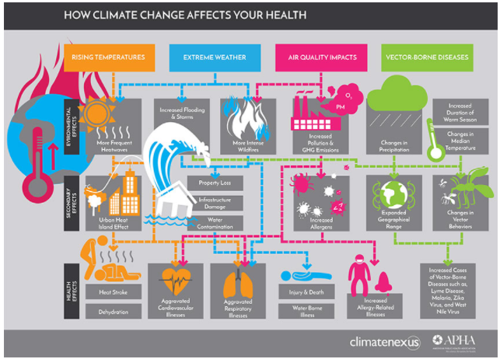
Notes:
Summary infographic from the APHA

Slide 29
6. Mentoring Schedule 11:00 AM EST / 8:00 AM PST
Dates | Topics | Q #s
#1 Tue April 25 1:00 PM EST/11 AM PST | Develop Site Team, Assess Local CC Risks, Feedback Loop, Resources
#2 Wed May 10 | Review Team Development & local CC Risks, Assess Climate-Related Risks | 1-19
#3 Wed June 7 | Review Risk Assessment Progress, Assess Risk Management | 20-40
#4 Wed June 28 | Review Risk Management, Resources, Procurement, Notification, Surveillance, Clinical Risk Management | 41-52
#5 Wed July 12 | Infrastructure/System Risk Management, Energy Use | 53-64
#6 Wed Aug 2 | Building Capacity, Sustainable Health, Mitigation | 65-78
#7 Wed Sept 13 | Review Building Capacity, Case Study Review, Exit Survey

Slide 30
Funding for the Climate Change Mentoring project is provided by:
:
An agency of the Government of Ontario, the Ontario Trillium Foundation (OTF) is one of Canada’s largest granting foundations. With a budget of over $136 million, OTF awards grants to some 1,000 projects every year to build healthy and vibrant Ontario communities. For more information, please visit: www.otf.ca

Slide 31
Questions? Contact Your Mentors:
Stewart Dankner stewart.dankner@uhn.ca
Ed Rubinstein edward.rubinstein@uhn.ca
Linda Varangu linda@greenhealthcare.ca
Kent Waddington kent@greenhealthcare.ca

